Slide 1
PL-600 Security

Slide 2
Agenda
Solution Architect’s role in security modeling
Discovery and learning your client’s environment
Controlling access to environments and resources
Controlling access to Microsoft Dataverse Data

Slide 3
Solution Architect role in security modeling
Leading the efforts to build a comprehensive security model that covers from authentication to data column level access
Being able to communicate the options for security architecture at a high level and help guide the team members through the architecture design choices
Being an advocate for simplicity, keeping the security from being overcomplicated while at the same time ensuring necessary protections

Slide 4
Security Architecture Process
Discovery - Learning the client environment
Authentication Strategy Development
Mapping security policies and requirements to design
Initial authentication blueprint created
Review and modification with customer security teams
Network Security
Authorization
Extracting security related requirements
Clarifying security requirements for simplification
Initial authorization blueprint created
Validation with business analysts and security teams

Slide 5
Discovery
A single Microsoft Power Platform project is unlikely to change organization authentication approach
Discover what is currently in use
Do they have Single Sign On today?
Are they using 3rd party products or just Azure Active Directory?
Do they use multi-factor authentication?
How is security managed?
Central security team or delegated?
What policies must be followed ?
How are application level entitlements managed? Which team will edit Microsoft Power Platform security?
How does organization structure influence security?

Slide 6
What should you try to learn about your client's environment to help you better architect the security model?
Classroom discussion

Slide 7
Learning the client environment
Do people work in teams that cross organization boundaries?
What are the privacy policies or data access laws influence?
Is there a data classification system?
What are the data retention policies?
What is the approval process for security architecture?

Slide 8
Controlling access to environments and resources

Slide 9


Layers of security
Contoso Corp.
1. Azure AD Conditional Access
Dev
Contoso EMEA (default)
Test
Contoso EMEA (default)
Prod
Contoso USA
2. Environment roles
Microsoft Dataverse
Microsoft Dataverse
3. Resource permissions for apps, flows, custom connectors…
PowerApps
Flows
PowerApps
Flows
Power Apps
Power Automate
Microsoft Dataverse
4. Microsoft Dataverse security roles
5. Cross-tenant inbound & outbound restrictions to the 300+ connectors to cloud services, content services, DBs, APIs, etc.
Notes:
PowerApps and Flow do not provide users with access to any data assets that they don’t already have access to. Users should only have access to data that they really require access to.

Slide 10
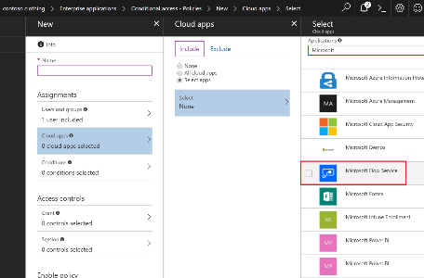
Azure AD - Conditional service access
Azure AD Premium required
Scenario coverage
Grant/block access based upon
User/Group
Device
Location

Slide 11
Securing environments with Security Groups
Security groups can be used to limit access to environments and to keep the user list streamlined to real users of the Microsoft Dataverse environment
Users added to the security group, are added to Microsoft Dataverse as users
When users are removed from the group, they are disabled in Microsoft Dataverse
When a security group is associated with an existing environment with users, all users in the environment that are not members of the group will be disabled
When no security group is associated all users with a Microsoft Dataverse license will be created as users and enabled in the environment
Notes:
All licensed users, whether or not they are members of the security groups, must be assigned security roles to access environments. You assign the security roles in the web application. Users can’t access environments until they are assigned at least one security role for that environment

Slide 12

Environment security and access control
Access is controlled at three levels
Environment roles
Resource permissions for apps/flows/custom connectors/etc.
Microsoft Dataverse security roles (if a Microsoft Dataverse database has been provisioned)
Once a Microsoft Dataverse database has been created, the Microsoft Dataverse security roles take over for controlling security
Env (no Microsoft
Dataverse)
Environment Roles (Maker/Admin)
App
Resource Permissions
(Owner/Contributor/User…)
Flow
Custom Connector
Env (w/ Microsoft
Dataverse)
Environment Roles (Maker/Admin)
App
Resource Permissions
(Owner/Contributor/User…)
Flow
Custom Connector
Env & Microsoft Dataverse Roles
(Maker/Admin/Customizer…)
Common Data Service
Notes:
All env admins and makers are migrated

Slide 13
Global and Service Admin accounts
Global Admin
Microsoft Power Platform Admin
Dynamics 365 Admin
Delegated Admin
Full administration to all services in tenant
Full administration to all Power Apps and Power Automate assets and environments
Microsoft Power Platform Admin role
Full administration to all services in tenant
Used for partners to provide support to customers
Full support for Power Apps and Power Automate coming soon

Slide 14
Why should a Solution Architect care about Data Loss Prevention policies?
Classroom discussion
Notes:
They ensure proper data flow in an organization following organization policies
They can prevent a developed solution from working properly if not included in your plans
Can break your solution after you deploy if they are added later

Slide 15
Controlling access to data

Slide 16
Authorization Architecture
Deciding who can get to what data and what services is an essential part of any solution
Every solution has unique requirements, but common capabilities and patterns can be identified and reused
A bad authorization architecture has far-reaching impact and is costly to fix
In the end, learn then think, then try & validate is often the best approach
Notes:
Some of the far-reaching impact of bad design
* manageability (nightmare to manage individual access)
* performance (POA growth during sharing)
* usability (cumbersome procedures to grant access)
* visibility (impossible to tell just by looking at the row who has access to it)
Anything else?

Slide 17
What are some common usage patterns within many business apps?
Classroom discussion

Slide 18
Common Business Scenarios
Active Involvement
Transactional Interaction
Management Oversight
Secondary Involvement
Reporting
Compliance
Notes:
Active involvement
Regular, significant involvement directly with the customer/deal ▪ Informed, with existing knowledge of the customer/deal and current related activity, and personal actions based on a direct relationship with the people involved
Secondary involvement
Informed involvement, maintaining active knowledge of activity but not directly participating or acting on the deal or with the customer, such as providing cover for absence of actively involved staff Support others who have a personal relationship with customer such as providing advice or support to the people actively involved, providing specialist knowledge to a specific deal or customer
Transactional interaction
Specific activity oriented involvement, for example, receiving and acting on a request to update a customer’s address ▪ No personal or on-going engagement, such as in a contact center
Management oversight
Managerial or governance responsibility across a business or geographical area ▪ Viewing and directing involvement of others rather than specific involvement
Reporting
Aggregated business reporting Data organized to preserve anonymity rather providing direct access to customers/deals
Compliance
Oversight read-only access to all rows for a business area

Slide 19
What strategies do you use for defining security roles?
Classroom discussion

Slide 20
Strategies for Building Security Roles
Position Specific vs. Baseline + Position vs. Capability
Roles unique to a business unit
Custom vs. Save As
Example – Life Insurance Agent
Position Specific
Baseline + Position
Baseline + Capability
Agent Role
Life Insurance Base Role
Agent Role
Life Insurance Base Role
Manage Agent Policies
Manage Agent Contacts
Mobile Agent

Slide 21
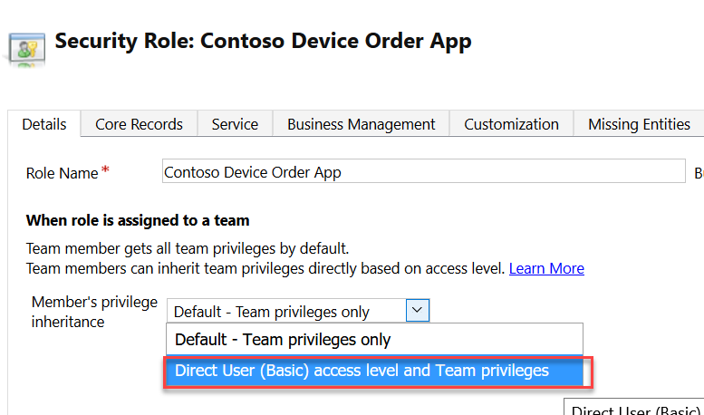
Leverage Direct Inheritance and assign roles to teams
Changing to Direct User treats privileges as if they were assigned directly to the user

Slide 22
What are some security challenges that business units can solve?
Classroom discussion

Slide 23
Business Units
Provide an efficient way of managing large number of users and row access
Permissions can be given to current business unit and all children
Avoid simply mirroring company org chart
Users can only be in one business unit, but can be in teams in other business units that give them similar effect

Slide 24
Azure Active Directory Group Teams
Connects a Microsoft Dataverse Team to a Security or Office group
Members of the Microsoft Dataverse team is managed by the Azure AD group
Team can own rows and have security roles
Used to manage app and Microsoft Dataverse data access
Notes:
More here https://docs.microsoft.com/en-us/power-platform/admin/manage-teams#edit-a-group-team

Slide 25
What’s the difference between Access Team and Owning Teams?
Classroom discussion

Slide 26
Owning Team vs. Access Team
Owning Team
Access Team
Can own rows
Can have security roles assigned
Scales up to 1,000 teams
Good when membership is pretty static
Row owned by organization
Members must have permissions
Scales over 1,000 teams
Can be dynamically created per row with a access template
Notes:
Make sure to expand on the differences between static access teams and those dynamically created

Slide 27
Security Hierarchies
CEO
Automatically roll up privileges to managers
Inherit privileges through multiple levels
Direct Manager
Read and Interact
2nd level manager
Read only
No need for customization to automate
Manager Of
Director
Manager Of
Manager Of
Manager
Manager
Salesperson
Salesperson
Salesperson
Salesperson

Slide 28
Hierarchy Types
Manager
Use SystemUser manager hierarchy
Position
Ability to specify explicit hierarchy
Multiple users can be added at each position level
Directly link users in management chain
Existing data
Needs configuration and maintenance
Can only create a single hierarchy
Cannot combine manager and position hierarchies at the same time
Position allows crossing business unit boundaries

Slide 29
When to use
Intended for those in direct management chain with need for detailed access
Not intended to be replacement for aggregated view and reporting at higher levels where BI/BU Scope typically more appropriate
Target is ~4 levels, maximum is 100 but this is extreme

Slide 30
Security across the layers of the application
API access must also be considered
Plug-in work can easily run with elevated access
All API code depending on the user authenticated can impersonate another user
Hiding columns on the user interface is not securing it
These are all examples that need careful thought and in some cases detailed code review can help

Slide 31
Automation of security can ease friction
You can control many aspects from creating teams to sharing rows via the API
This can be done based on events that occur in the system
E.g. Backup account manager automatically gets rights to manage account while primary is on vacation

Slide 32
Separate and Optimize Usage Patterns
Optimize for different usage patterns
Use different security model features to provide necessary access

Slide 33
Wrapping up
Security modeling is unique to each solution – there is no one size fits all
Different industries and business models follow different approaches to granting access
Look for common patterns that emerge from requirements, often these emerge for how the relationship with the customer is managed
Above all keep things a simple as possible while still meeting the business needs to secure data and optimize the user experience

Slide 34
Group exercise: Security
Evaluate needs
Address security concerns
Notes:
You are building a solution for Fabrikam to track visitors to a showroom and manufacturing site. Some of the visitors are potential purchasers and some are just there to see the magic of the robots working.

